Slide 1
Orchid fleck dichorhavirus: a new Brevipalpus transmitted virus fresh from Florida
A. Fife¹, D. Carrillo², G. Knox³, F. Iriarte⁴, K. Dey⁵, A. Roy⁶, R. Ochoa⁷, G. Bauchan⁸, M. Paret^{4,9}, X. Martini¹* ¹ University of Florida, Department of Entomology and Nematology, North Florida Research and Education Center, Quincy FL 32351 ² University of Florida, Department of Entomology and Nematology, Tropical Research and Education Center, Homestead FL 33031 ³ University of Florida, Department of Environmental Horticulture, North Florida Research and Education Center, Quincy FL 32351 ⁴ University of Florida, Department of Plant Pathology, North Florida Research and Education Center, Quincy FL 32351 ⁵ The Florida Department of Agriculture and Consumer Services, Division of Plant Industry, Section of Plant Pathology, Doyle Conner Building, 1911 SW 34th street, Gainesville, FL 32608 ⁶ United States Department of Agriculture – Agriculture Research Service, Molecular Plant Pathology Laboratory, 10300 Baltimore Ave, Bldg. 4 BARC-West, Beltsville, MD 20705 ⁷ United States Department of Agriculture - Agriculture Research Service, Systematic Entomology Laboratory 10300 Baltimore Ave, Bldg. 5 BARC-West, Beltsville, MD 20705 ⁸ United States Department of Agriculture - Animal and Plant Health Inspection Service, Electron and Confocal Microscopy Unit, Bldg. 12 BARC-West, 10300 Baltimore Ave, Beltsville, MD 20705 ⁹ Plant Pathology Department, University of Florida, Gainesville, FL 32611

Slide 2
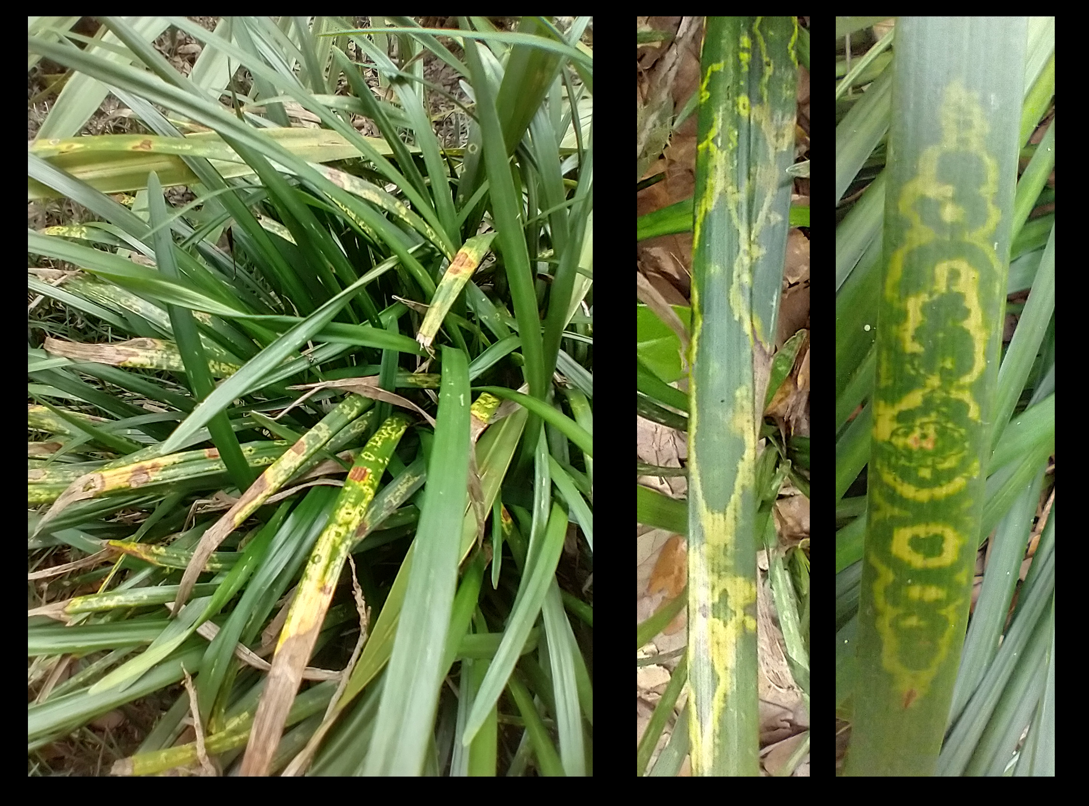
Chlorotic ringspot symptoms on Giant Lilyturf (Liriope spp., cv. ‘Gigantea’)

Slide 3
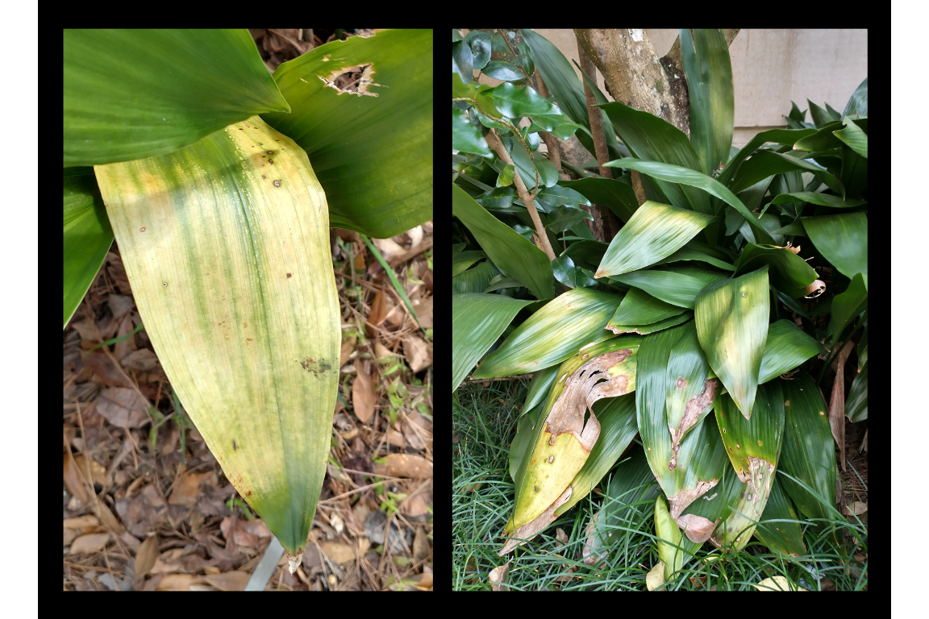
Chlorotic leaves on Cast Iron Plant (Aspidistra elatior)

Slide 4
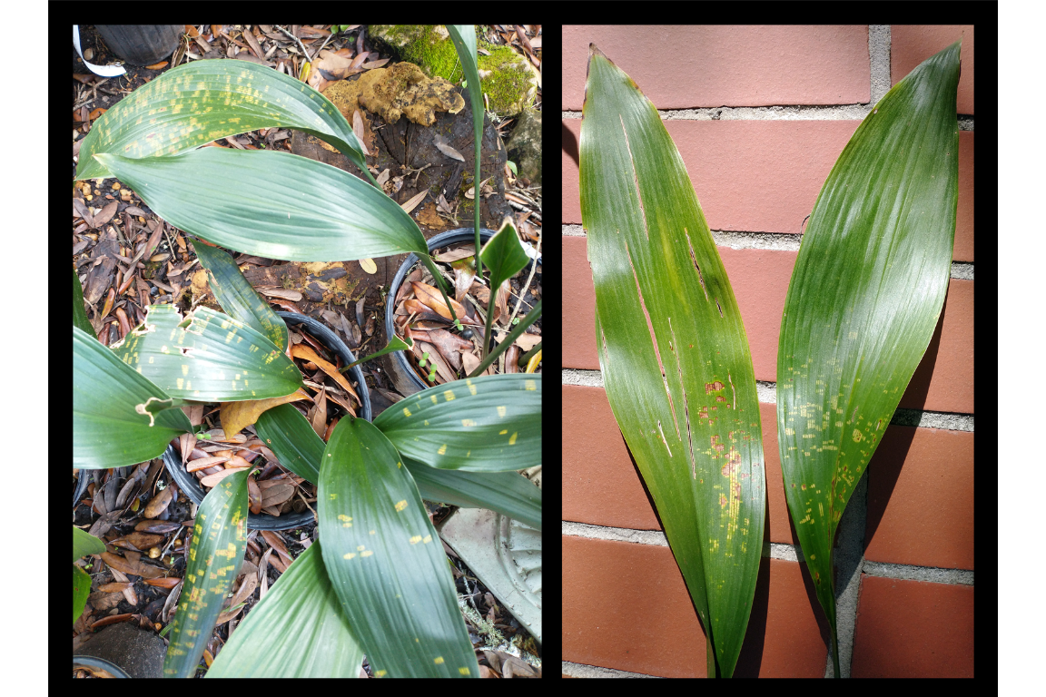
Chlorotic spots on A. elatior - Early infection?

Slide 5
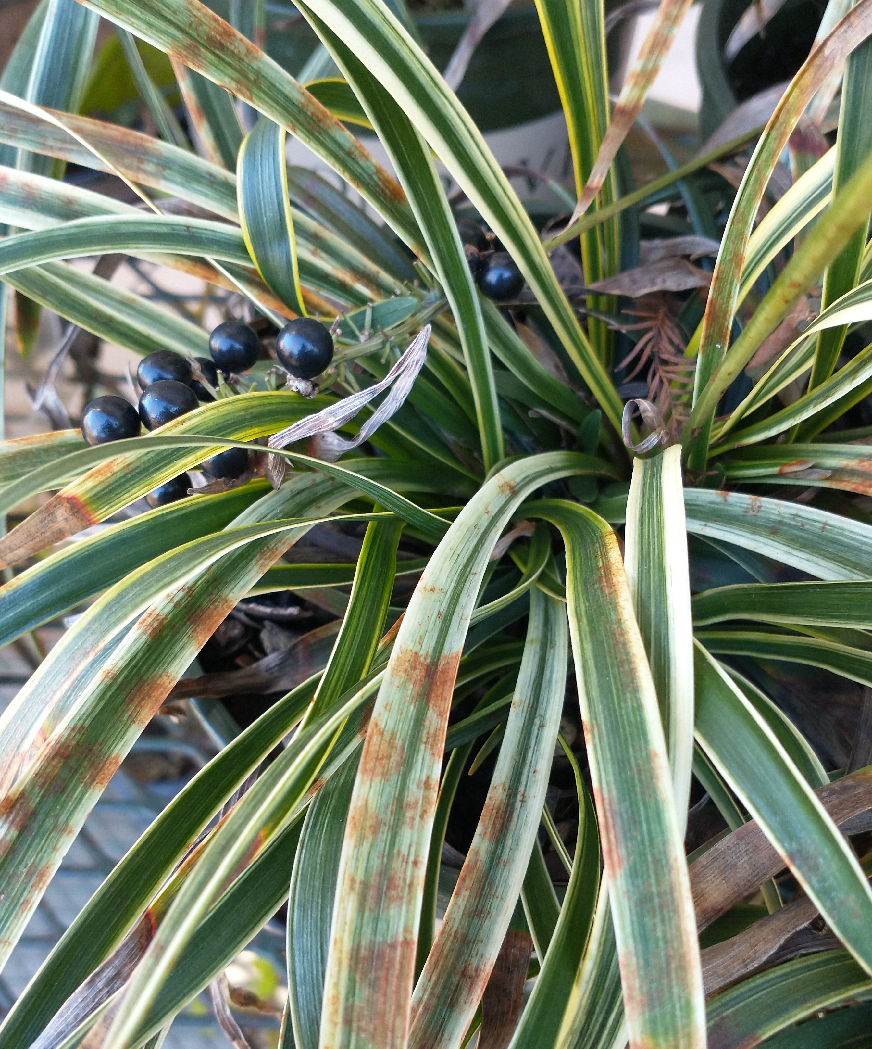
What was causing these symptoms?
Tested negative for begomovirus, potyvirus, tospovirus as well as for Impatiens necrotic spot virus, Tobacco mosaic virus and Tomato spotted wilt virus
Sent to the Florida Department of Agriculture and Consumer Services (FDACS) $→$ sent to USDA
Symptoms on varigated Ophiopogonae

Slide 6
Confirmation: Orchid fleck dichorhavirus (OFV)
Identified using OFV specific conventional reverse transcription polymerase chain assay (RT-PCR) assay + Sanger sequencing + quantitative RT-PCR (RT-qPCR)
Presence of Orchid fleck dichorhavirus confirmed using OFV generic R2-Dicho-GF and R2-Dicho-GR primers (Roy et al. 2020)
Sanger sequencing of RT-PCR amplicons shared 98% nucleotide identity with orchid strains of OFV: OFV-Orc1 and OFV-Orc2 (GenBank Accession numbers: AB244418 and LC222630) (Kondo et al. 2006, 2017).

Slide 7
What is OFV?
Type member for Dichorhavirus, family Rhabdoviridae
Other dichorhaviruses: Citrus chlorotic spot virus, Citrus leprosis virus N, Clerodendrum chlorotic spot virus and Coffee ringspot virus
OFV infects 50+ plant species, including Orchidaceae, Asparagaceae (Nolinoidaea), and Rutaceae (Citrus)
Flat mites from the genus Brevipalpus Donnadieu (Trombidiformes: Tenuipalpidae) only known vectors of dichorhaviruses
Symptoms of OFV on Oncidium

Slide 8
Distribution of OFV
content
First described infecting Cymbidium orchids in Japan (Doi et al. 1977)
OFV and OFV-like rhabdoviruses have been reported worldwide
Asia, Africa, North America, South America, Europe and Oceania
Prevalence of OFV and its mite vector is thought to be associated with the movement of infected orchids (Dietzgen et al. 2018)

Slide 9
Maps
Additional samples were taken from other Nolinoidaea, including Liriope muscari, Ophiopogon japonicus, O. intermedius and Aspidistra elatior Blume (Asparagaceae: Nolinoidaea) in Leon and Alachua counties.
content

Slide 10
Mites Recovered
Three Brevipalpus mite species were recovered from OFV-infected plants:
Brevipalpus californicus sensu lato
B. obovatus Donnadieu
B. confusus Banks
One of these species is presumably responsible for OFV transmission
Brevipalpus californicus (Banks) group are the only known to transmit OFV in a persistent propagative manner
Brevipalpus mite species complex contains cryptic species (Childers and Rodrigues 2011)
content

Slide 11
OFV is an issue for Florida agriculture
The dichorhavirus that infects citrus in Hawaii, Mexico, Colombia, and South Africa are identical to the OFV in gene order, content, and the genome sequence.
ICTV: Officially, OFV consists of two orchid strains (OFV-Orc1 and OFV-Orc2) and two citrus strains (OFV-Cit1 and OFV-Cit2)
Orchid strains of OFV infects citrus (Roy et al. 2020), but none of the citrus strains have been reported from any orchid species
OFV in Florida represents a concern for horticulturists who grow orchids, Liriope, Ophiopogon, or other susceptible Asparagaceae species which are commonly used in landscaping
content

Slide 12
Further considerations
Florida is also home to a plethora of native and naturalized orchid species
Cultivating Vanilla in southern Florida (Chambers et al. 2019)
Famous Ghost Orchid, [Dendrophylax lindenii (Lindl.) Benth. ex Rolfe].
Citrus leprosis was present in Florida during the 1860’s and eradicated in the mid-1960s
Kitajima et al. (2011) found that the Citrus Leprosis virus (CiLV) which previously affected Florida citrus was a nuclear type of citrus leprosis closely related to OFV strains (Roy et al. 2013)
Association of a distant relative of OFV named Citrus leprosis dichorhavirus-N0 (CiLV-N0) was confirmed in relation to the leprosis disease outbreak in Florida (Hartung et al. 2015).

Slide 13
Threat for the multi-billion dollar citrus industry
Detection of OFV-Orc1 in South Africa (Cook et al. 2019) in C. sinensis (Navel and Valencia orange) and OFV-Orc2 in Hawaii (Velarde et al. 2021) in C. reticulata (mandarin) and C. jambhiri (rough lemon) highlights the threat of different strains of OFV
Lastly, some OFV isolates are known to be involved with citrus leprosis disease in Mexico (Roy et al. 2015)

Slide 14
Mites: a large part of the problem
Florida has various mite species of Brevipalpus:
B. californicus and B. yothersi are both known vectors of Dichorhaviruses (OFV) and Cileviruses (Citrus Leprosis) (Knorr 1968, Kondo et al. 2003, Beltran-Beltran et al. 2020)
B. obovatus is a suspected vector as well (Childers et al. 2003)
Brevipalpus mites are known to have cryptic species complexes and unresolved questions about host specificity
Critical to identify the vector of OFVs in Florida and monitor its spread to determine the risk this virus represents for the native plants, agriculture and the ornamental/landscaping industries of Florida and the surrounding regions.
content

Slide 15
Conclusions
Three new hosts from the family Asperagaceae
Need to know the extended host range of OFVs
Survey of Florida’s citrus growing regions, esp. plants within the families Rutaceae and Asparagaceae
Mite species determination: PCR methods?
Mite transmission assays

Slide 16
Acknowledgements
We would like to give a special thanks to the Tallahassee Museum for their patience, cooperation, and support with collecting plant samples. We also want to thank Drs. Sam Bolton, FDACS and Aline Tassi, Univ. of Sao Paulo, Brazil for checking the mites we have sent for species validation. We are especially indebted to the late Dr. Gary Bauchan for his contributions to this study and the field of acarology, he will be greatly missed. This research was partly funded by the USDA National Institute of Food and Agriculture, Hatch project FLA-NFC-005607. Mention of trade names or commercial products in this publication is solely for the purpose of providing specific information and does not imply recommendation or endorsement by the USDA; USDA is an equal opportunity provider and employer.

Slide 17
References
Beltran-Beltran, A. K., M. T. Santillán-Galicia, A. W. Guzmán-Franco, D. Teliz-Ortiz, M. A. Gutiérrez-Espinoza, F. Romero-Rosales, and P. L. Robles-Garcı́a. 2020. Incidence of citrus leprosis virus c and orchid fleck dichorhavirus citrus strain in mites of the genus Brevipalpus in Mexico. Journal of Economic Entomology. 113: 1576–1581.
Chambers, A. H., P. Moon, V. Edmond, and E. Bassil. 2019. Vanilla cultivation in southern Florida. EDIS. 2019: 7.
Childers, C. C., and J. C. V. Rodrigues. 2011. An overview of Brevipalpus (acari: Tenuipalpidae) and the plant viruses they transmit. Zoosymposia. 6: 180–192.
Childers, C. C., J. C. V. Rodrigues, K. S. Derrick, D. S. Achor, J. V. French, W. C. Welbourn, R. Ochoa, and E. W. Kitajima. 2003. Citrus leprosis and its status in Florida and Texas: Past and present. Experimental and Applied Acarology. 30: 181–202.
Cook, G., W. Kirkman, R. Clase, C. Steyn, E. Basson, P. H. Fourie, S. D. Moore, T. G. Grout, E. Carstens, and V. Hattingh. 2019. Orchid fleck virus associated with the first case of citrus leprosis-N in South Africa. European Journal of Plant Pathology. 155: 1373–1379.
Dietzgen, R. G., J. Freitas-Astúa, C. Chabi-Jesus, P. L. Ramos-González, M. M. Goodin, H. Kondo, A. D. Tassi, and E. W. Kitajima. 2018. Dichorhaviruses in their host plants and mite vectors, pp. 119–148. In Advances in Virus Research. Elsevier.
Doi, Y., M. U. Chang, and K. Yora. 1977. Orchid fleck virus. CMI/AAB descriptions of plant viruses.
Hartung, J. S., A. Roy, S. Fu, J. Shao, W. L. Schneider, and R. H. Brlansky. 2015. History and diversity of citrus leprosis virus recorded in herbarium specimens. Phytopathology. 105: 1277–1284.
Kitajima, E. W., C. M. Chagas, M. T. Braghini, L. C. Fazuoli, E. C. Locali-Fabris, and R. B. Salaroli. 2011. Natural infection of several Coffea species and hybrids and psilanthus ebracteolatus by the coffee ringspot virus (CoRSV). Scientia Agricola. 68: 503–507.
Knorr, L. C. 1968. Studies on the etiology of leprosis in citrus. In International Organization of Citrus Virologists Conference Proceedings.
Kondo, H., K. Hirota, K. Maruyama, I. B. Andika, and N. Suzuki. 2017. A possible occurrence of genome reassortment among bipartite rhabdoviruses. Virology. 508: 18–25.
Kondo, H., T. Maeda, Y. Shirako, and T. Tamada. 2006. Orchid fleck virus is a rhabdovirus with an unusual bipartite genome. Journal of General Virology. 87: 2413–2421.
Kondo, H., T. Maeda, and T. Tamada. 2003. Orchid fleck virus: Brevipalpus californicus mite transmission, biological properties and genome structure. Experimental and Applied Acarology. 30: 215–223.
Roy, A., N. Choudhary, L. M. Guillermo, J. Shao, A. Govindarajulu, D. Achor, G. Wei, D. D. Picton, L. Levy, M. K. Nakhla, J. S. Hartung, and R. H. Brlansky. 2013. A novel virus of the genus cilevirus causing symptoms similar to citrus leprosis. Phytopathology. 103: 488–500.
Roy, A., A. L. Stone, G. Otero-Colina, G. Wei, R. H. Brlansky, R. Ochoa, G. Bauchan, W. L. Schneider, M. K. Nakhla, and J. S. Hartung. 2020. Reassortment of genome segments creates stable lineages among strains of orchid fleck virus infecting citrus in Mexico. Phytopathology. 110: 106–120.
Roy, A., A. L. Stone, J. Shao, G. Otero-Colina, G. Wei, N. Choudhary, D. Achor, L. Levy, M. K. Nakhla, J. S. Hartung, W. L. Schneider, and R. H. Brlansky. 2015. Identification and molecular characterization of nuclear citrus leprosis virus, a member of the proposed dichorhavirus genus infecting multiple citrus species in Mexico. Phytopathology. 105: 564–575.
Velarde, A. O., A. Roy, C. Padmanabhan, S. Nunziata, M. K. Nakhla, and M. Melzer. 2021. First report of orchid fleck virus associated with citrus leprosis symptoms in rough lemon (Citrus jambhiri) and mandarin (C. reticulata) the United States. Plant Disease.

